Slide 1
Operators

Slide 2
An operator is a symbol that operates on a value or a variable.
Arithmetic operator
Relational Operator
Logical Operator
Assignment Operator
Bit wise Operator
Increment and Decrement Operator
Conditional Operator
Special Operator

Slide 3
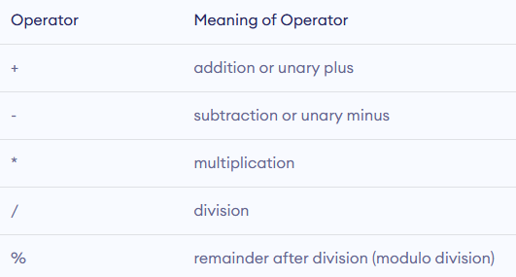
Arithmetic Operator
An arithmetic operator performs mathematical operations such as addition, subtraction, multiplication, division, etc on numerical values (constants and variables).

Slide 4
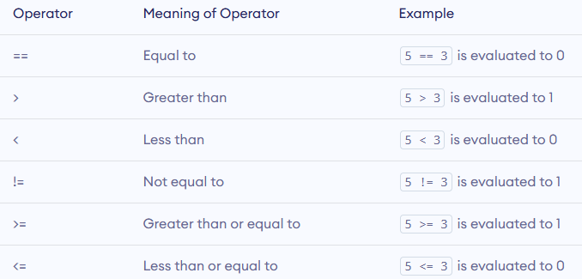
Relational Operator
A relational operator checks the relationship between two operands. If the relation is true, it returns 1;
if the relation is false, it returns value 0.

Slide 5
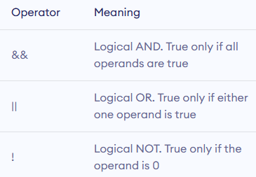
Logical Operators
Logical operators are commonly used in decision making in C programming.
An expression containing logical operator returns either 0 or 1 depending upon whether expression results true or false.

Slide 6
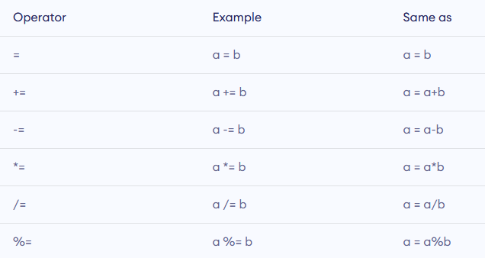
Assignment Operator
An assignment operator is used for assigning a value to a variable.

Slide 7
Increment and Decrement Operators
We have post increment a++ and Pre increment ++ a.
Similarly Post decrement a-- and pre decrement –a

Slide 8
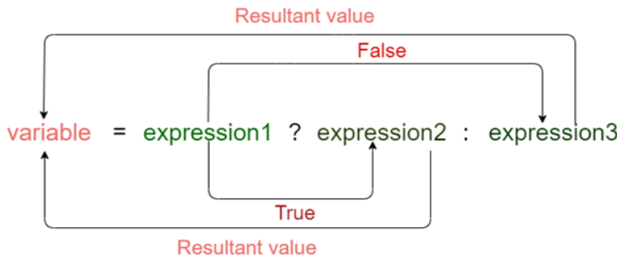
Conditional Operator
The conditional operator is also known as a ternary operator. The conditional statements are the decision-making statements.which depends upon the output of the expression.
Expression1? expression2: expression3;

Slide 9
Bitwise Operators
Bitwise operators are used in C programming to perform bit-level operations.

Slide 10
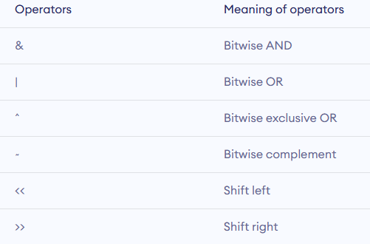

Slide 11
Special Operator
Comma Operator
sizeof operator
Comma operators are used to link related expressions together.
The sizeof is a unary operator that returns the size of data ( constants, variables, array, structure etc,.)

Slide 12
#include <stdio.h>
int main()
{
int a; float b; double c; char d;
printf("Size of int %d\n",sizeof(a));
printf("Size of float=%d\n",sizeof(b));
printf("Size of double=%d \n",sizeof(c));
printf("Size of char=%d \n",sizeof(d));
return 0; }

